Slide 1
Transferability of the Defense-GAN Technique to Physical Adversarial Examples
Midterm Update (#2)
Rohan Pradhan - Bibin Sebastian - Karthik Raja - Chamanpreet Kaur - Mihir Pathare

Slide 2
Review of Motivation
Research focuses around attacks/defenses on digital images
Physical world image alterations are more realistic in a practical setting
Generative Adversarial networks are gaining popularity and through different variants, trainability is getting better
How do we combine a so-called state-of-the-art defense and test it in a practical setting?

Slide 3
Outline
Physical Adversarial Examples
Overview of Classifier
Generation of Physical Examples
Updated Camera Setup
Results
Analysis - Moire Pattern
Defense-GAN
Issues Faced
Hyperparameter tuning
Initial Results
Next Steps
Use Physical Adversarial Examples on Defense-GAN protected model
Generate new types of adversarial examples

Slide 4
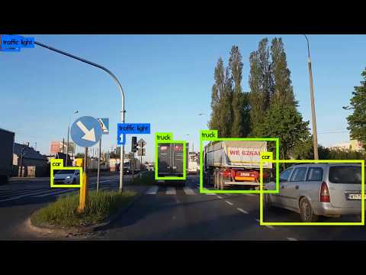
Review of Motivation

Slide 5
Experimental Setup/Equipment for Reproduction of Results at Midterm
Tools used:
Cleverhans FGSM attack
Defense-GAN

Slide 6
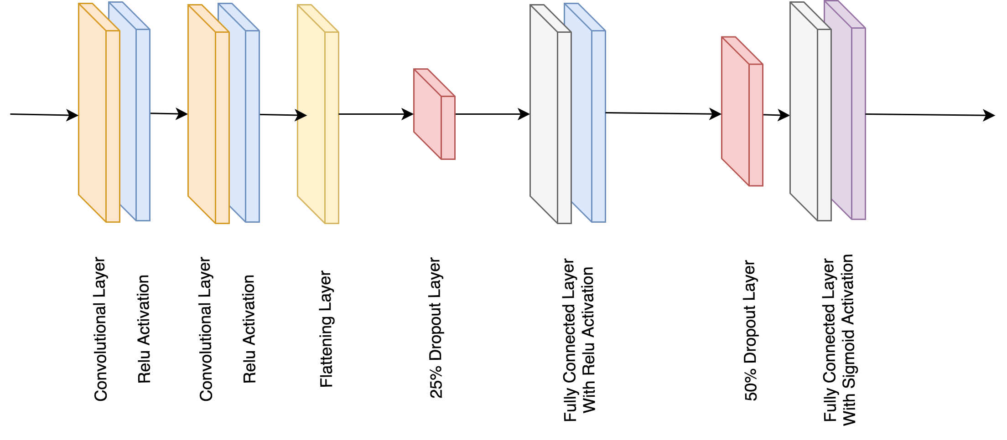
Classifier Model-A

Slide 7
Experimental Setup/Equipment for Reproduction of Results at Midterm
Equipment used:
Google Cloud Deep Learning Virtual Machine
NVidia Tesla P4 - 8GB GPU
13 GB of RAM
2 vCPUs
Microsoft LifeCam HD-3000 Webcam- see difficulties faced
Logitech c922x Webcam (new)

Slide 8
Midterm Experiments
CleverHans
Create a CNN classifier and train on celebA dataset
Classification task - Male or Female
Use CleverHans library to attack digital images through FGSM
Modified attack files for new dataset (CelebA)
Shapes of input tensors
Model inputted into FGSM attack

Slide 9
Midterm Experiments
Generation of Physical Examples
Created script and pipeline to automatically generate clean and adversarial physical examples
Script loads file through openCV
Displays image on external monitor
Captures image using webcam
Captured image autocropped to only face
Auto labels image
See Difficulties Faced Section (Need for different webcamera)

Slide 10
Midterm Experiments
Defense-GAN
Trained Defense GAN model on celebA dataset
Not able to reproduce the results on the celebA dataset
Debugging Samangouei et al paper’s code to run trained Defense GAN Model
See Difficulties Faced Slide
Notes:
removing the transform_type from get_celeba
shape property for LazyDataset
casting to shape list
Modified changes in dataset.py and blackbox.py

Slide 11
Initial Results
ACCURACY OF THE MODEL
Adversarial Method | Clean Image | Adversarial Image
FGSM ϵ=0.001 | 94% | 90%
FGSM ϵ=0.003 | 94% | 48%
FGSM ϵ=0.005 | 94% | 30%
FGSM ϵ=0.009 | 94% | 22%
FGSM ϵ=0.05 | 94% | 6%

Slide 12
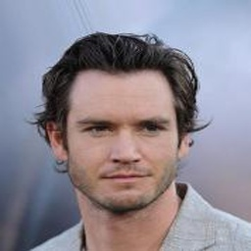


Initial Results
Clean Image (acc = 94%) Adversarial Image (ε = 0.005, acc=30%) Adversarial Image (ε=0.05, acc=6%)

Slide 13
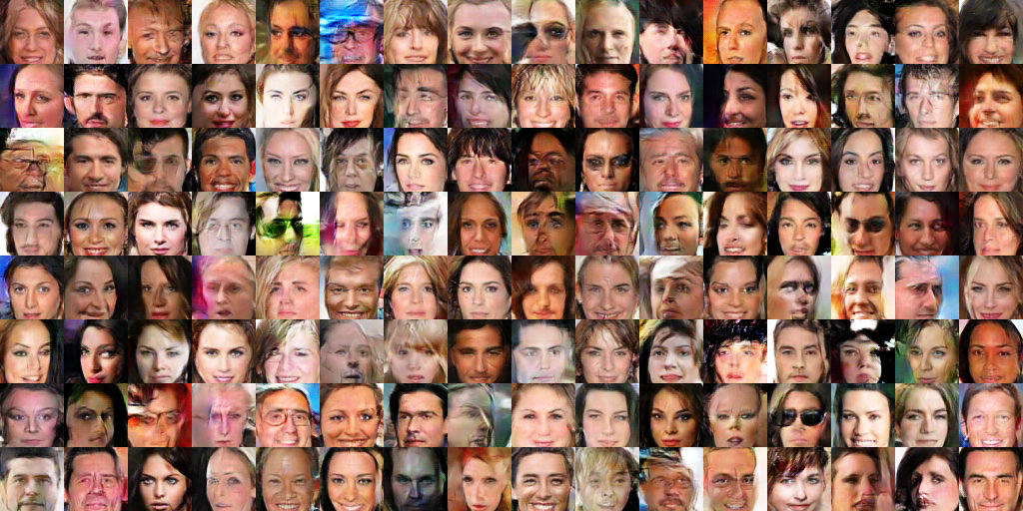
GAN Training Summary - 130,000 Iterations

Slide 14
Difficulties Faced
Reproducibility of Defense-GAN Technique
Authors claims that Defense-GAN is transferable on other datasets via “plug-and-play” interface
Technique is not reproducible and debugging is necessary to change datasets
Authors of paper contacted - conceded that results are not reproducible
Longer training times due to 256x256 image size compared to 64x64 in the paper

Slide 15
Difficulties Faced
Efficiently Capturing Physical Adversarial Examples
Planned on using webcam pointed at laptop screen to capture images
Too much reflective glare
Webcam pointed at LCD monitor with anti-reflective coating
Camera not autofocusing correctly and overexposing image (see example)
Cannot adjust/access Microsoft camera intrinsic settings

Slide 16
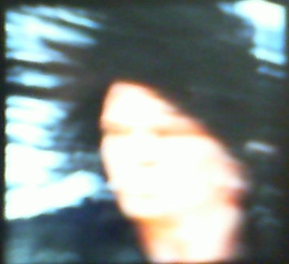
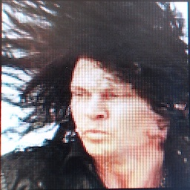

Difficulties Faced
Efficiently Capturing Physical Adversarial Examples
Microsoft Lifecam
Logitech C922x
Ground Truth

Slide 17
Next Steps
Modify webcam used
Allow for more granular control over image properties
Access to device drivers through openCV
Turn off auto-exposure
Turn off auto-ISO
Turn off auto-focus
Modify/Continue debugging Defense-GAN code to allow for correct usage with CelebA dataset
Use physical generated adversarial examples on classifier model protected with modified Defense-GAN

Slide 18
References
Samangouei, Pouya,Maya Kabkab, and Rama Chellappa. ”Defense-GAN: Protecting classifiers against adversarial attacks using generative models.” arXiv preprint arXiv:1805.06605 (2018).
Kurakin, Alexey, Ian Goodfellow, and Samy Bengio. ”Adversarial examples in the physical world.” arXiv preprint arXiv:1607.02533 (2016).
https://medium.com/@devnag/generative-adversarial-networks-gans-in-50-lines-of-code-pytorch-e81b79659e3f
https://skymind.ai/wiki/generative-adversarial-network-gan

